Slide 1
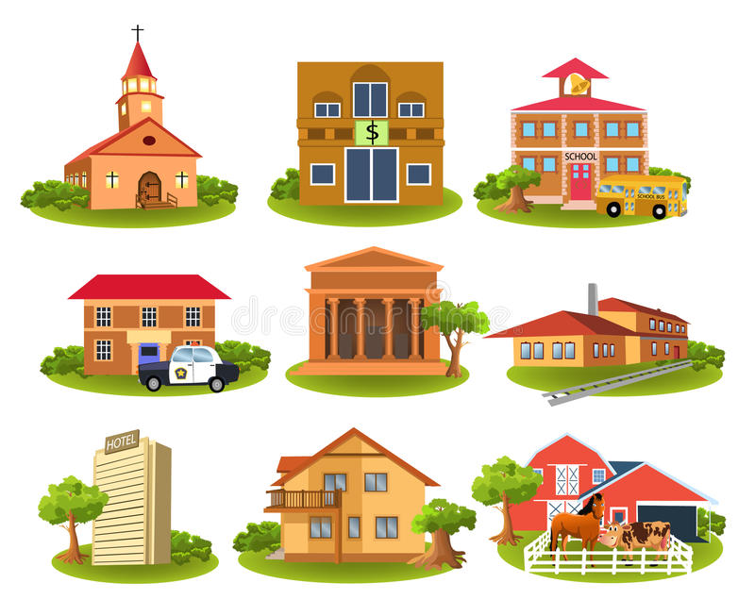
МОУ Туношёнская СШ ЯМР имени Героя России Селезнева А.А.
Презентация на тему: «Where do you live?»
Подготовил учитель иностранных языков
Семенычева Е. А.
2018 год

Slide 2
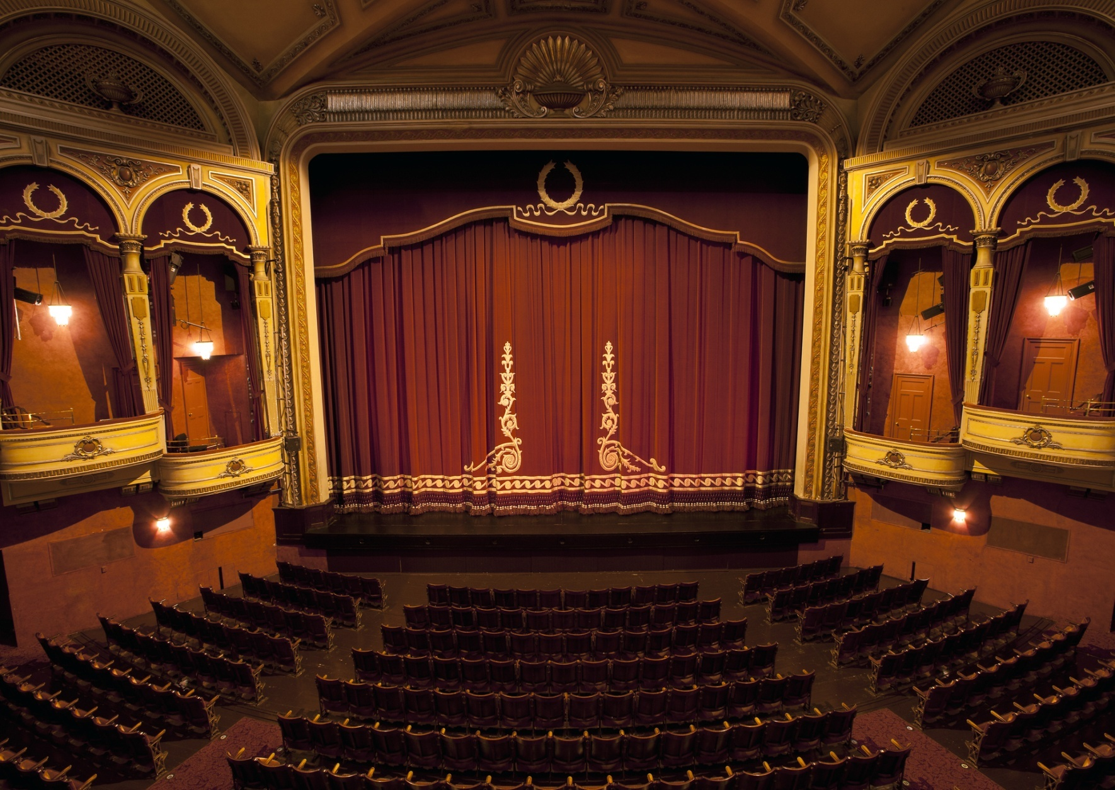
Where can you see a puppet show?

Slide 3
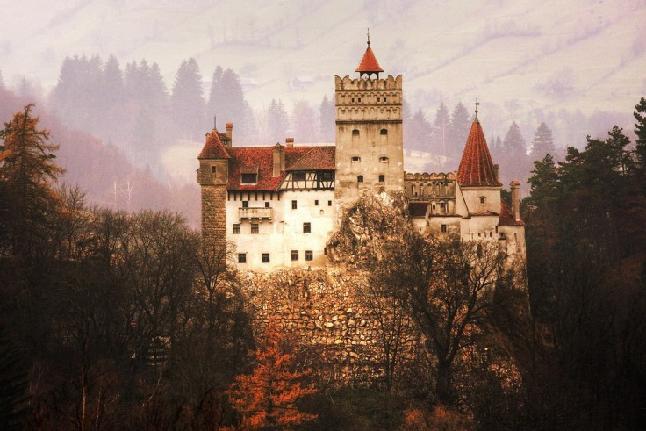
Where can the kings live?

Slide 4
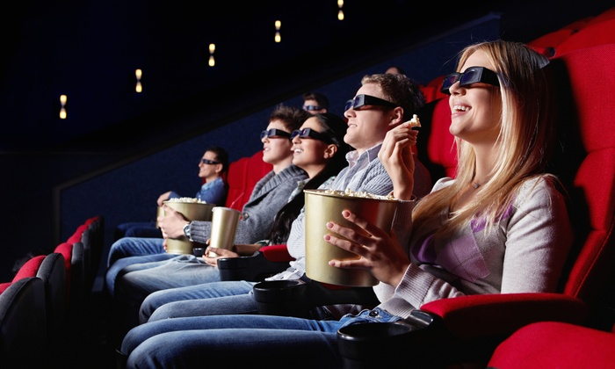
Where can you see cartoons?

Slide 5
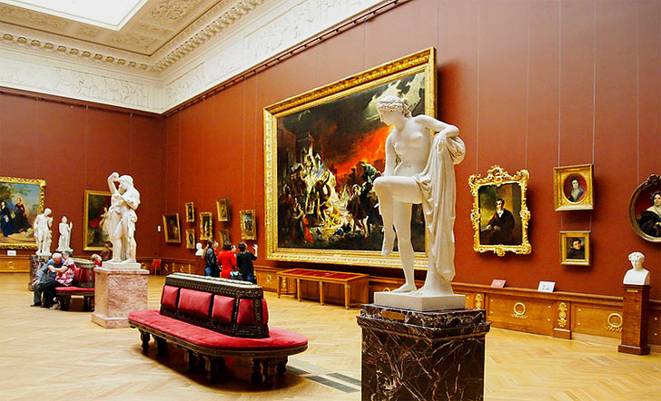
Where can you see an old picture?

Slide 6
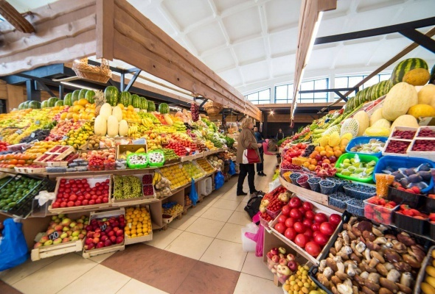
Where can you buy vegetables and fruit?

Slide 7
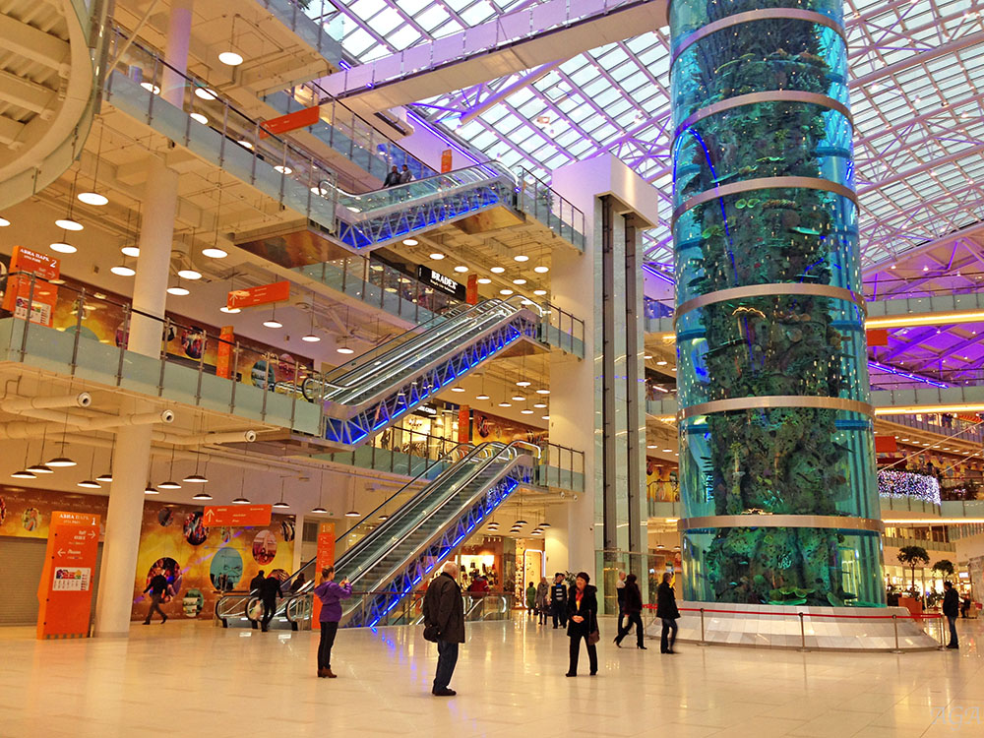
Where can you buy new clothes?

Slide 8
Where can you read books?

Slide 9
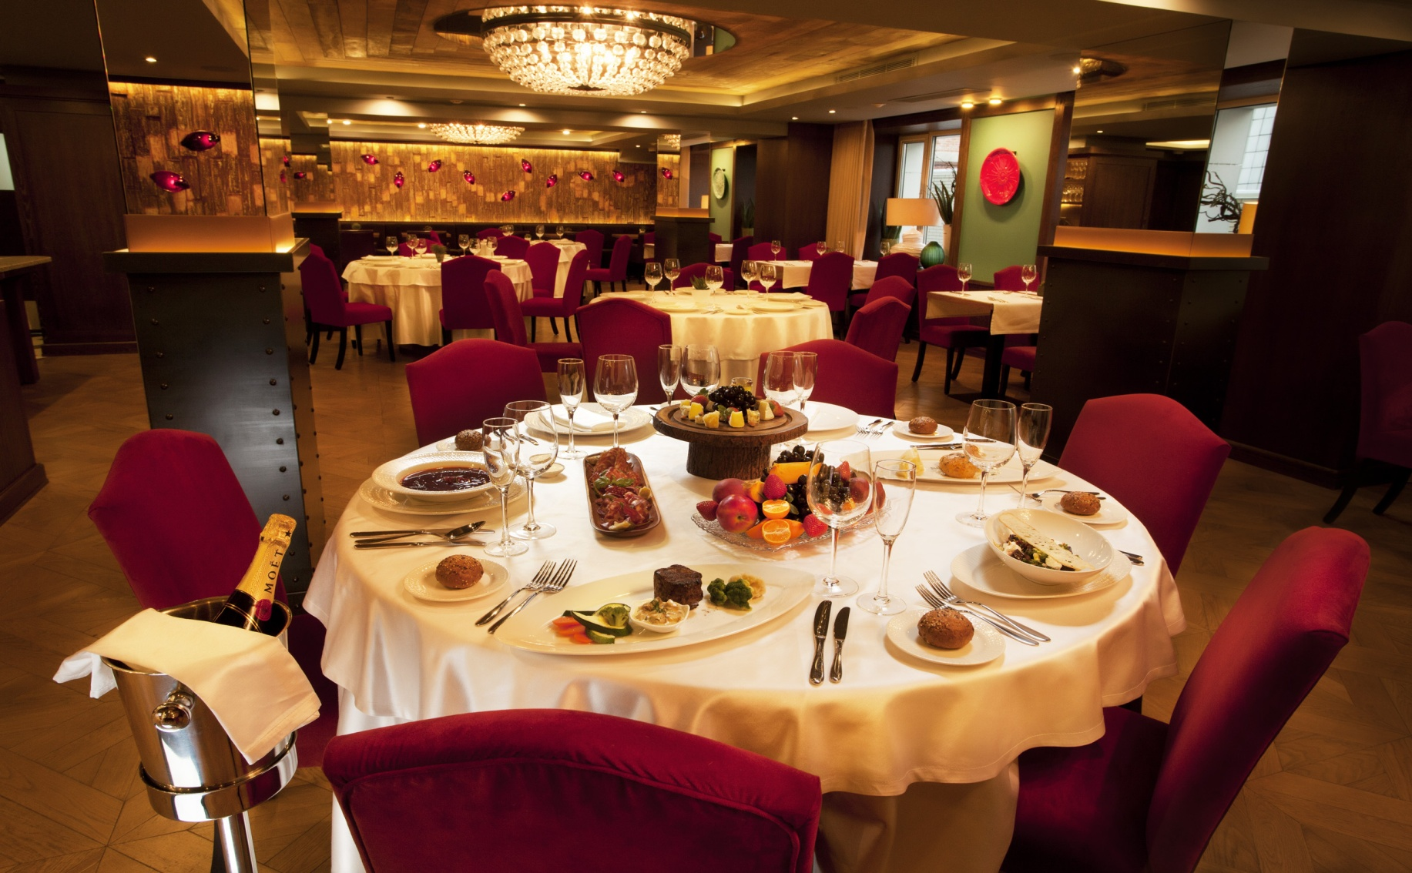
Where can you have supper?

Slide 10
Where can you see many students?

Slide 11
Where can you get your letters?

Slide 12
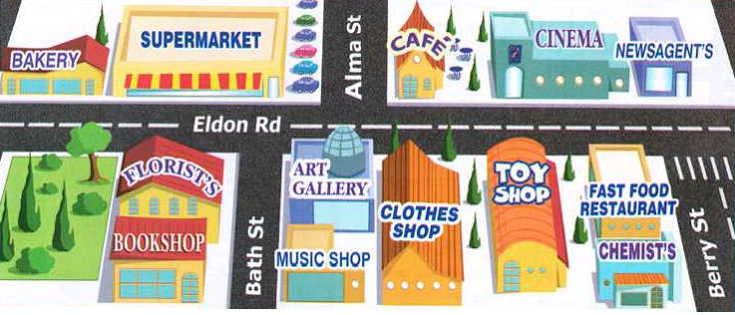

Slide 13
opposite
There is a (место) next to the (место)
behind

Slide 14
Homework
To get 4 you should do the crossword;
To get 5 you should draw the picture and write why you like the place where do you live.

Slide 15
Choose your mark
«5» | «4» | «3» | «2»

Slide 16
Thank you for your work.
The lesson is over.

